Slide 1
Evaluating Active Learning
Tracy Pritchard, PhD
Carolyn Smith, PhD, RN

Slide 2
Learning Objectives
Define the degrees of active learning
Discuss different approaches to evaluating active learning
Outline facilitators and barriers to evaluating use of technology in active learning strategies
Share lessons learned from evaluating implementation of active learning strategies

Slide 3
Active Learning-What IS it?
Log into Socrative.com
  Select Log-in
  Click on Student Log-in
  Enter room 447594

Slide 4
Active Learning-What is it?
Methods that engage students in the learning process
Students required to think about the meaning of learning activities
Degrees of active learning
  Low, Moderate, High complexity
  Alignment with Blooms Revised Taxonomy
Intention behind strategies selected

Slide 5
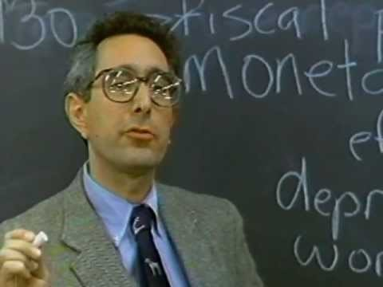
Active Learning-What it is NOT

Slide 6
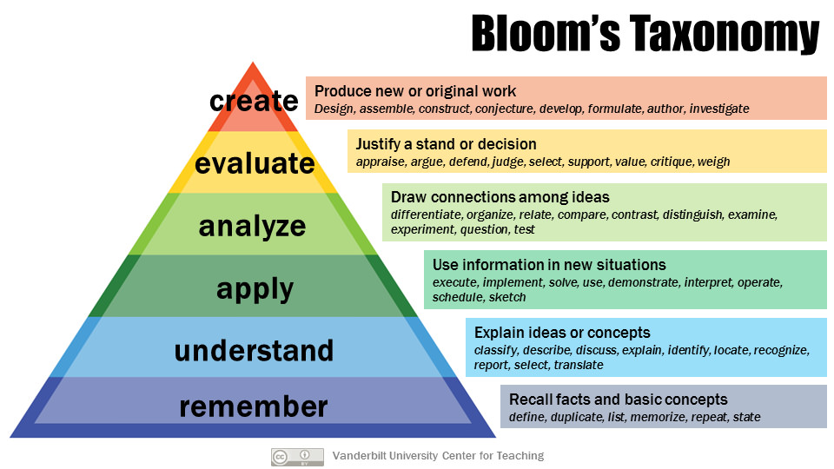

Slide 7
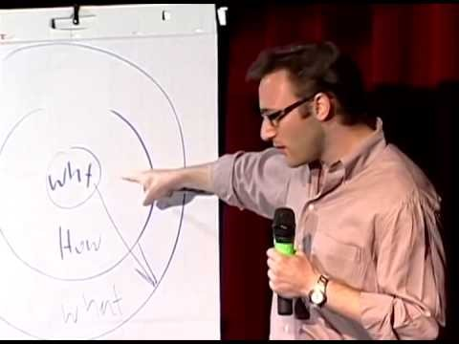
Why does this matter?

Slide 8
Why does this matter for you?
Unmute and share

Slide 9
How do we know if active learning is making a difference?

Slide 10
Outcomes Associated with
Active Learning
Engagement
Satisfaction
Performance
  Grades
  Application of content

Slide 11
Tips
Identify what active learning strategies you are evaluating
Identify goal you are trying to achieve using that active learning strategy
Determine your audience for evaluation: students, faculty or both

Slide 12
Active Learning Inventory
Van Amburgh et al, 2007. American Journal of Pharmaceutical Education. 71(5)
  Developed an inventory to measure the type, amount, length and complexity of active learning
  Aimed to assess the breadth and depth of strategies were used
Good resource for identifying appropriate active learning strategies aligned with the level of complexity of thinking required by the learner (Bloom’s taxonomy)

Slide 13
Preconception Check
Socrative Activity
  List active learning strategies you know or have heard of

Slide 14
Complexity | Active Learning Strategy | Description
Low Complexity | Question and Answer | Students orally respond to a question, comment, etc. either voluntarily or by cold calling.
 | One Minute Paper/Focused Listing/One Sentence Summary | Short writing task designed to allow students to focus attention on a single important item, name, or concept from a particular lesson/session.
 | Think/Pair/Share | Short, individual written response to a prompt/ question, then instructed to share and discuss briefly with partner, then asked to share with larger group.
 | Brain Dump/Free Write | Short write in which students write down everything they know about an announced topic.
 | Muddiest Point | At some point during or after an in-class presentation, students write a quick response to the prompt, “What was the muddiest point in __?”
 | Misconception/ Preconception Check | Simple technique for gathering information on what students perceive they already know.
 | Application Activity | Written activity in which students apply 1-2 principles and concepts in real life situation.
 | Student-Generated Questions | Students create questions for quizzes of exams that are crafted to capture central elements in the course.
 | Formative Quizzes/ Surveys | Ungraded quizzes/ surveys to determine comprehension.
 | Personal Response System | Students participate in lecture by responding to questions/statements via computers/ wireless technology.
 | Self/Peer Formative Assessments | Activities that require students to assess performance against applicable criteria; extend to offer specific suggestions for improvement.
Adapted from Van Amburgh et al, 2007. American Journal of Pharmaceutical Education. 71(5)

Slide 15
Complexity | Active Learning Strategy | Description
Moderate Complexity | Small Group Presentations/Discussions | Presentations/discussions of course material.
 | Role Playing/Simulations/Games | Students and/or faculty performing specific roles for demonstration purposes. Simulations/games include guiding principles, specific rules and structured relationships.
 | Categorizing Grid/Pro-Con Grid | Students are presented with 2-3 important categories along with scrambled subordinate terms, images, equations or other items that belong in one or another of the subordinate categories.
 | Defining Features Matrix/Memory Matrix | Students categorize concepts presented according to presence/absence of defining features.
 | Debates | Small or large group structured exploration of central concepts, data, beliefs, values.
 | Peer Teaching | Students teaching each other basic and/or intermediate levels of course materials or needed skills.
 | Concept Maps | Drawings or diagrams that show the mental connections that students make between a major concept presented and other concepts they have learned.
High Complexity | Cases | Scenarios that require students to integrate their skills to solve problems that relate to course materials.
 | Cooperative Cases | Scenario-based problem-solving activity using small groups to tackle specific questions/issues from larger list.
 | Jigsaw | Team-based: each member becomes subject matter expert in 1 or 4 areas selected from current course material. Each member teaches their subject matter.
 | Cooperative Learning/ Problem Based Learning | Students work together to learn course knowledge and to develop course skills.
Adapted from Van Amburgh et al, 2007. American Journal of Pharmaceutical Education. 71(5)

Slide 16
Active Learning in Online Environment
Novice
Focus on low to moderate complexity activities
Consider using discussion boards and quiz functions in LMS
Use WebEx (live) or Kaltura (pre-recorded) group-led learning and presentations
Tech-Savvy
Can use any level of complexity activity
Student group work via LMS Tools such as WebEx and Teams
Flipgrid for engaging students in debate/discussion

Slide 17
Practicality of Active Learning
How do you do this?
Activity--
  We will assign each person to a breakout room
    Identify a learning objective from one of your classes
    What level of blooms is this focused on?
    Looking at the Active Learning Inventory, what type of activities could match well with this learning objective?
    How might you go about applying that activity?
    How could this activity be delivered online?
    There is a link to the Bloom’s Taxonomy and the Active Learning Inventory resources and a learning activity template being shared in the chat box.

Slide 18
Lesson Learned
Do an initial survey of your class
  What active learning strategies have you implemented
  What technology are you using
  Compare to what active learning strategies and technological tools students perceive to be used for your class

Slide 19


Slide 20
Examples of Alignment/Misalignment Between Active Learning Strategies Used from Faculty Vs. Student Perspective

Slide 21
Findings from an Active Learning Survey from College of Nursing
Top 3 Active Learning Strategies from the Student Perspective (n = 73)
  Field experience/learning practicum
  Concept maps
  Question and answer
Top 3 Active Learning Strategies from the Faculty Perspective (n=8)
  Question and answer
  Formative quizzes
  Small group presentations

Slide 22
Findings from Active Learning Survey
Top 4 Active Learning Strategies that incorporated the iPad from the Student Perspective (n = 73)
  Formative quizzes (85%)
  Peer teaching (80%)
  Concept maps (78%)
  Think pair share (77%)
Top 3 Active Learning Strategies that incorporated the iPad from the Faculty Perspective (n=8)
  Think pair share (75%)
  Peer teaching (50%)
  Concept maps (50%)

Slide 23
Rapid Cycle Quality Improvement
What are we trying to accomplish?
How will we know if a change is an improvement?
What changes can we make that will result in improvement?
  -Thomas Nolan, PhD

Slide 24
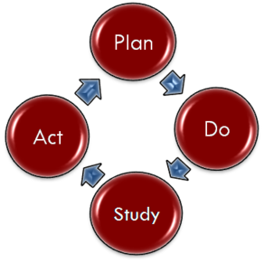
Rapid Cycle Quality Improvement

Slide 25
Ethical Considerations
Undue influence and manipulation
Voluntariness
Confidentiality vs anonymity
IRB review
  Quality improvement vs. research involving human subjects

Slide 26
Lessons Learned
Engage stakeholders early in the process (be inclusive)
Define your goal or purpose for implementing the education intervention
Identify strong advocates for the project
Develop an evaluation plan before implementation
  Need to collect baseline information
  What will you use to compare your outcomes?
  How will you know the intervention worked or did not work?

Slide 27
Change is the end result of all true learning.
Leo Buscaglia

