Slide 1
Parental Time Off Benefits
UC College of Medicine
UC Physicians

Slide 2

What is parental leave?
Time off from work to care for a newborn or newly adopted child.
  Maternity leave
  Paternity leave
  Adoption leave
Factors to consider:
  How much time off?
  Paid or unpaid?

Slide 3


Around the world
All countries (except 1) legally mandate some form of parental leave.
  2014 survey of 185 countries
Most countries mandate paid leave
  Social Security or Employer Liability
  12-52+ weeks at 50-100% of pay.
Only 2 countries don’t mandate paid leave.
  Suriname
  United States

Slide 4

Family Medical Leave Act (FMLA)
Employers must give up to
12 weeks off every year.
Job is protected during leave.
Time off is unpaid.
  Employee may use vacation time or sick time during FMLA.
For child birth/bonding, time must be used within one year of birth or adoption.

Slide 5














Employer Benefits
Many employers offer benefits more generous than the minimum required by the law.

Slide 6

Academic Medicine Trends
2017 survey of top 91 academic medical centers*:
  48 (53%) offered paid parental leave
    Parental leave defined as leave dedicated to new mothers, fathers, or primary caregivers
    Paid leave defined as protected leave with some compensation without mandated use of sick, vacation or other personal time off.
  Of 18 Midwest schools, 8 offer paid parental leave
    5 offer <= 6 weeks
    3 offer > 6 weeks
    10 offer 0 weeks
* According to 2016 US News and World Report

Slide 7

2018 UCP benefit expansion
How can we:
  Provide more paid time off to new moms and dads
  Protect the financial viability of each practice
  Care for patients
  Meet department scheduling needs

Slide 8

Get Creative: A Layered Approach
Multiple programs
Maximum Benefits
Manageable Cost

Slide 9
AAUP Faculty benefits
FMLA – 12 WEEKS
Medical/Disability Period
Childrearing Period
Paid Parental Leave
Vacation Time
6 weeks of 100% pay
Used in lieu of sick time
Intended to be taken as soon as possible following birth/adoption
Must be completed within 6 months
Sick time may be used before birth if medically necessary
20 days/year
Accrues to 240 days (higher limit if hired before 10/1/16)
Faculty member may choose to take unpaid time during childrearing and “save” vacation.

Slide 10
Dually compensated provider benefits
FMLA – 12 WEEKS
Medical/Disability Period
Childrearing Period
Sick Time
Short-Term Disability
Paid Parental Time Off
Vacation Time
15 days/year
For “disability” due to childbirth
No limit on accrual
70% of pay, tax-free
After 2 week elimin period
After sick time runs out
For “disability”
2 weeks of pay
May be used anytime during 1st 12 weeks
20 days/year
Accrues to 240 days (higher limit if hired before 10/1/16)

Slide 11
Example 1
Date of Hire: Jan, 2017
Date of Delivery: Mar, 2018
Sick Time:
W 1 - 3
STD:
W 4 - 6
PPTO:
W 7-8
Vacation:
Weeks 9 - 12

Slide 12
Example 2
Date of Hire: Feb, 2012
Date of Delivery: May, 2018
Sick Time:
Weeks 1 - 6
PPTO:
W 7-8
Vacation:
Weeks 9 - 12

Slide 13
Example 3
Date of Hire: Jul, 2018
Date of Delivery: Aug, 2018
PPTO:
W 1 - 2
STD:
W 3 - 6
Unpaid:
Weeks 7 - 12

Slide 14

2018 Maternity leaves
Average length is 12 weeks
Average unpaid time is 2 days
  Medical leave portion is fully paid
  Childrearing portion may be partially unpaid if individual has less than 4 weeks of vacation time
  Emergency Medicine and General Medicine Hospitalists do not accrue vacation

Slide 15

Planning your parental leave
Contact your College of Medicine (COM) HR Consultant
COM HR processed:
  2016: 44 parental leaves
  2017: 41 parental leaves
  2018: 66 parental leaves
        50 maternity
        16 paternity

Slide 16
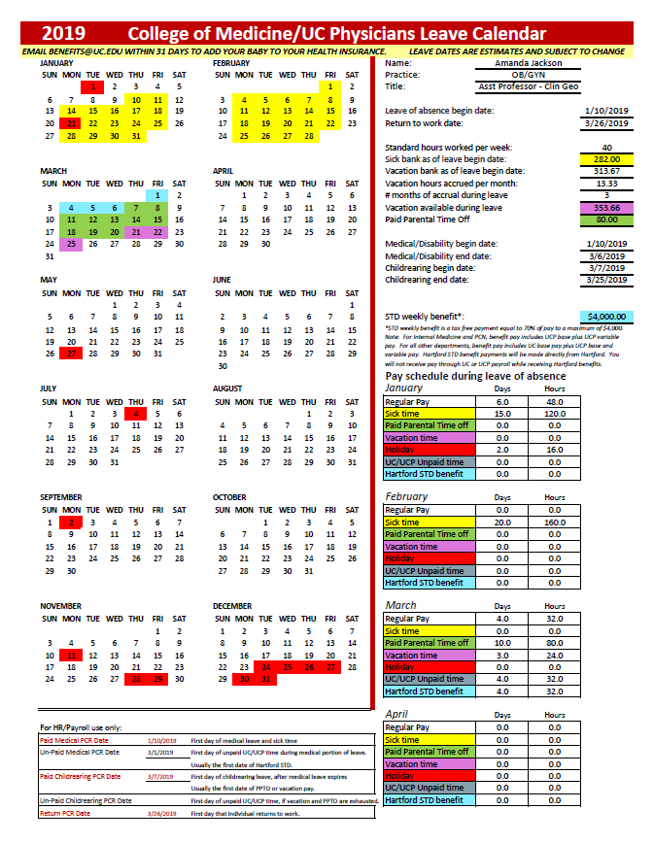
Personalized Plan
Your HR Consultant will prepare a personalized leave plan that optimizes the benefits available to you.

Slide 17

Questions?

