Slide 1
Supervising Medical Students:
Your Role as an Educator
The University of Cincinnati
College of Medicine

Slide 2
0
First, Thank You!
…for teaching our medical students. They are the future of medicine, both for our patients and for us. They will care for our loved ones, and your role as physician educator is crucial for their development.
During these critical times, our community partners are even more crucial to the future of medicine and we thank you!

Slide 3
Outline
Medical education during COVID-19
Rationale for residents and other supervising physicians as teachers
UCCOM curriculum and key contacts
Four primary roles of supervising physicians as supervisors, role models, teachers, and evaluators
UCCOM policies

Slide 4
Coronavirus Precautions
For UCCOM/VSLO students, the expectation is to follow the CDC guidelines and institutional guidance of the student’s clinical site for COVID-19.
CDC Guidelines for Isolation and Precautions
FOR UC HEALTH:
Please follow the link provided to find out the procedure in the following situations:
1) If you are experiencing ANY respiratory symptoms.
2) If you have received a positive COVID test result.
3) If you have been in contact with someone who has COVID.
UC Health Guidelines for COVID-19 Symptoms/Exposure and Returning To Work
FOR CCHMC: Call 803-SAFE for initial testing and all return to work
NOTE: Students must facilitate their own testing but can find additional testing resources at the following page www.uc.edu/publichealth
If there are any questions, students are welcome to contact Deana Brown (Deana.Brown@uchealth.com).

Slide 5
Supervising Physicians and Residents are Key to Medical Education

Slide 6
Rationale for Attending Physicians as Teachers
The passing of wisdom during experience
The 30,000 foot view of medicine, whereas earlier learners might be learning more ground level
More experience over time in supervising trainees of different levels (e.g. student, resident, fellow)
Teaching is our professional responsibility
Teaching can aid our own learning

Slide 7
Rationale for Residents/Fellows as Teachers
Residents have the most contact with students
  Increased opportunity to observe the students and to be observed by the students
Can still relate to the ground level and connect to the 30,000 foot view
Opportunity to develop teaching and evaluation skills
Teaching is our professional responsibility
Teaching can aid our own learning

Slide 8
Four Primary Roles for Supervising Physicians in Medical Education
Supervisor
Role model
Teacher
Evaluator
In order to do this, you need to know about our curriculum.

Slide 9
Cincinnati Medicine Curriculum Overview
Competencies
Curriculum and Timeline
M3/4 Requirements
Clinical Clerkships Student Learning Outcomes

Slide 10
Cincinnati Medicine Program Competencies
Competency | Competency Description
Patient Care | Provide patient-centered care that is compassionate, appropriate, and effective for the treatment of health problems and the promotion of health.
Knowledge for Practice | Demonstrate knowledge of established and evolving biomedical, clinical, epidemiological and social-behavioral sciences, as well as the application of this knowledge to patient care.
Practice-Based Learning and Improvement | Demonstrate the ability to investigate and evaluate one’s care of patients, to appraise and assimilate scientific evidence, and to continuously improve patient care based on constant self-evaluation and life-long learning.
Interpersonal and Communication Skills | Demonstrate interpersonal and communication skills that result in the effective exchange of information and collaboration with patients, their families, and health professionals.
Professionalism | Demonstrate a commitment to carrying out professional responsibilities and an adherence to ethical principles.
Systems-Based Practice | Demonstrate an awareness of and responsiveness to the larger context and system of health care, as well as the ability to call effectively on other resources in the system to provide optimal health care.
Interprofessional Collaboration | Demonstrate the ability to engage in an interprofessional team in a manner that optimizes safe, effective patient- and population-centered care.
Personal and Professional Development | Demonstrate the qualities required to sustain lifelong personal and professional growth.
*Note these are the domains of the AAMC Physician Competency Reference Set (and slightly different than the 6 ACGME core competencies).

Slide 11
Cincinnati Medicine M1/2 Requirements
M1 YEAR Requirements
Foundational Courses
Fundamentals of Molecular and Cellular Medicine
Physician and Society
Musculoskeletal/Integumentary
Nervous System
Blood System
Clinical Experiences
Healthcare Emergency Management I
Clinical Skills (CS)
Fundamentals of Doctoring (FOD)
M2 YEAR Requirements
Foundational Courses
Cardiovascular and Pulmonary
Renal and Gastrointestinal
Physician and Society
Endocrine and Reproductive
Multi-Systems
Clinical Experiences
Healthcare Emergency Management II
Clinical Skills (CS)
Fundamentals of Doctoring (FOD)

Slide 12
2024-25 M3 Clerkships and M3 Electives
Family Medicine (4 weeks total)
4 weeks outpatient
Internal Medicine (8 weeks total)
4 weeks inpatient, 4 weeks outpatient
Neuroscience (4 weeks total)
Two 2-week experiences
Obstetrics & Gynecology (6 weeks total)
2 weeks GYN surgery, 2 weeks L&D, 2 weeks outpatient
  Pediatrics (8 weeks total)
  4 weeks inpatient, 4 weeks outpatient
  Psychiatry (6 weeks total)
  Two 3-week experiences
  Surgery (8 weeks total)
  4 weeks core surgery, 4 weeks specialty
Specialty Electives/Clerkships (two, 2-week experiences)*
Students must choose 2 of the following: Anesthesiology, Cardiovascular ICU, Clinical Oncology, Dermatology, Emergency Medicine, Geriatrics, MICU, Ophthalmology, Otolaryngology, Pathology, Radiology, Urology
*Exposure (2 weeks) that is pass/fail (as opposed to an intensive experience); exception is Ophthalmology which is graded using Honors/High Pass/Pass categories.
https://med.uc.edu/education/medical-student-education/office-of-medical-education/integrated-curriculum/m3-integrated-clinical-clerkships
Use this hyperlink to find more information about M3 rotations

Slide 13
Third Year Core Clinical Clerkships Student Learning Outcomes
Gather appropriate and accurate patient history.
Perform appropriate patient exam for the presenting problem/reason for visit.
Generate an appropriate problem-based differential diagnosis and plan.
Follow through on the appropriate diagnostic and therapeutic action plan.
Communicate patient information to the clinical team in oral form.
Communicate patient information to the clinical team in written form.
Communicate effectively with patients of diverse backgrounds (e.g. age, gender, social, racial, and economic backgrounds).
Demonstrate a commitment to self-directed learning by developing your knowledge outside of the traditional learning environment (e.g. demonstrate ability to retrieve and cite evidence from reliable references to advance patient care)
Collaborate with an interprofessional health care team (i.e. communicate with nurses, respiratory therapist, social workers, pharmacist, primary care physician, etc.).
Demonstrate professional behavior in clinical setting (e.g. appearance, reliability, punctuality, motivation, commitment, and respect).
The core clerkship outcomes are aligned with the Entrustable Professional Activities (EPAs) as defined by AAMC.

Slide 14
Cincinnati Medicine M4 Requirements
M4 YEAR Requirements
4 weeks Internal Medicine (IM) Acting Internship (AI)
4 weeks Specialty AI in other specialty of choice
12 weeks of Intensive Clinical Experience (ICE)
  Minimum expectation of 20 hrs/week of direct patient care
12 weeks of general electives
_________________________________________
32 weeks total

Slide 15
Fourth Year Required Internal Medicine AI Learning Outcomes
Write admission orders.
Answer a nurse call.
Write a discharge summary.
Write a cross-cover note.
Give and receive patient handoffs (both in writing and verbally) to transition care responsibly.
Speak with specialist/subspecialist colleagues to request consultation.
Negotiate conflict with colleagues.
Deliver bad news.
Discuss an adverse event with a patient.
Obtain informed consent.
Gain familiarity with obtaining advanced directives and documenting DNR.
Review pronouncing death and filling out a death certificate.

Slide 16
Dates and Timeline
Pay attention to rotation dates to help students transition to new rotations and met goals before finishing rotations
  Click here for M3 Dates
  Click here for M4 Dates
Pay attention to timing of educational conferences and other demands on students
Pay attention to clerkship assessments
  High stakes end of clerkship NBME subject exam (shelf)
  OSCE testing

Slide 17
Key Contacts for the M3/4 Curriculum

Slide 18
Clerkships and Clerkship Administration
Know the Clerkship Director and Clerkship Coordinator
first and foremost
Clerkship
Family Medicine
Internal Medicine
Neuroscience
Obstetrics & Gynecology
Pediatrics
Psychiatry
Surgery
Clerkship Director / Clerkship Coordinator
Dr. Sarah Pickle/ Nancy Jamison
Dr. LeAnn Coberly / Gabriela Ionascu
Dr. Starla Wise / Angela Bustamante
Dr. Jane Morris / Natalie Cassady
Dr. Corinne Lehmann / Mimi Pence
Dr. Peirce Johnston / Sonya Kirkland
Dr. Latifa Silski / Nikki Norman
Use this hyperlink to find more information about clerkship administration and contact information
Click here for contact list!
https://med.uc.edu/education/medical-student-education/office-of-medical-education/integrated-curriculum/m3-integrated-clinical-clerkships

Slide 19
Cincinnati Medicine Administrative Team
Office of Medical Education (OME)
Provides central coordination of the curriculum and ensures all operational matters of the academic programs are compliant with accreditation standards.
https://med.uc.edu/education/medical-student-education/office-of-medical-education/home
Associate Deans:
  Dr. Pamela Baker
  Dr. Bruce Giffin
Assistant Dean: Dr. Laurah Lukin
Director of Medical Education: Dr. Tracy Pritchard
M1/2 Curriculum Director: Dr. Stephen Baxter
M3/4 Curriculum Director: Dr. Danielle Weber
M3/4 Program Director: Gina Burg
Director of Electives: Dr. Amy Guiot
Offices of Medical Student Affairs
Student Affairs: Provides academic support, coordination of academic schedules, advising, financial services, and student wellness activities.
https://med.uc.edu/education/medical-student-education/student-affairs
Associate Dean: Dr. Dawn Bragg
Assistant Dean: Dr. Laura Malosh
Career Development Director: Dr. Alice Mills
Director of Financial Services: John Stiles
Registrar: Kristy Wilson

Slide 20
Cincinnati Medicine Administrative Team
Office of Medical Student Admissions and Special Programs
https://med.uc.edu/admissions/medical-student-admissions
Admissions: Oversees the selection process of medical students.
Associate Dean: Dr. Donald Batisky
Office of Diversity, Equity & Inclusion
Supports an inclusive environment for all and welcomes diversity in every aspect of daily operations.
https://med.uc.edu/diversity/home
Assistant Dean: Dr. Bi Awosika
Learning Specialist: Dr. Swati Pandya

Slide 21
Role of Supervising Physicians

Slide 22
Supervising Medical Students
Ideally students are directly participating in patient care as much as possible. What this looks like and amount of supervision required may vary based on setting or specific student.
Participating in patient encounters includes:
  Acting as the patient’s caregiver (with appropriate supervision), including ongoing management of hospitalized patients
  Aiding in complete or problem focused history and physical
  Aiding in diagnostic and therapeutic plan

Slide 23
Supervising Medical Students
Observation in patient encounters implies no direct patient contact (e.g. taking a history or performing a physical, participating in diagnostic/therapeutic plan)
Try to minimize pure observation as students learn best by participating in patient care
Observation can be powerful teaching tool though, when used intentionally
  Have students observe a physical exam maneuver new to them or a procedure they have never done
  Have students observe difficult conversations or discussions outside their scope (e.g. obtaining consent)
  Encourage students to observe another care provider (e.g. consultant provider, allied health professional, etc)

Slide 24
Supervising Medical Students
Assign patients and tasks to promote student’s learning and to integrate them into team
Assure adequate supervision of students as they provide patient care, including performing procedures and examinations
Consider whether direct or indirect supervision is appropriate
  If indirect supervision, need to double check everything
Students may not accompany monitored patients off the floor
Co-sign notes or write “agree with” notes within 24 hours. Ask your educational team about your own documentation rules with med student notes.
Co-sign orders (when appropriate)

Slide 25
Physicians as Role Models

Slide 26
You are a Role Model
Students see everything you do. You are role modeling through your behaviors and actions even when you do not think you are.
This can be more powerful than the “explicit curriculum” taught
Be aware of:
  Comments in the presence of students who may not fully appreciate the difference between venting to colleagues and disparaging patients
  Discussions with colleagues who are also friends in the presence of students, what you say to friends may not be appropriate to say in a work environment or around students
  Be aware of and prepared to respond to microaggressions in the learning environment

Slide 27
You are a Role Model
We expect you to role model the professional attributes that medical students are expected to develop:
  Duty
  Integrity
  Respect
  Honesty
  Compassion
  Fidelity
  Dependability
You are expected to maintain a positive learning environment for all our medical students
The learning environment impacts students in many ways, including their view of you and your specialty

Slide 28
Physicians as Teachers

Slide 29
Role as a Teacher
Create a positive learning environment
  Involve student and show they are valued (know their name and use it, ask them what their goals are and areas they wish to improve)
  Be approachable (open to answering questions, elicit their questions)
Create psychological safety
  Key is to create a non-threatening atmosphere where they feel open sharing their uncertainties, mistakes, confusion, etc.
  Make it known you are interested in helping them get better and be the best physician they can be.
  You can have psychological safety and still have high expectations and accountability! This is actually the recipe for learning and growth!

Slide 30
Role as a Teacher
Find teachable moments throughout the day
  Connect teaching to a patient as much as possible
  Help students develop their thought process by Thinking Out Loud or sharing reason behind decisions
  Ask students to apply information to a new patient or different scenario
Go to the bedside together
  Help students prepare to evaluate a patient (what history and/or exam items are important to obtain for the CC)
  Observe students (direct supervision) and provide feedback
  Demonstrate/teach a skill (can exam a patient together, have them observe you but tell them what they are observing and why)
  Get paged to evaluate a patient? Take them with you and tell them what you are thinking.

Slide 31
Role as a Teacher
Think about the level of the learner
  What do they already know? What do they need help with? Explore this so you can focus teaching points to help them reach next level (concept of zone of proximal development)
  Help students learn to adapt their history taking and physical exam to different contexts or more complicated cases
  Help students learn how to organizing information for presentations and notes
Facilitate students developing clinical reasoning skills
  Help them develop frameworks for their clinical reasoning (e.g. approach to a patient with abdominal pain)
  Help them understand how to prioritize different pieces of information (e.g. normal heart exam does not rule out cardiac pathology)

Slide 32
Role as a Teacher
Personalize learning when possible
  What do they want to learn? What specialty are they interested in? Explore this and then provide relevant teaching pearls, give related “chalk talks,” or assign readings.
  Example: could focus on pre-surgical evaluations for a student going into orthopedics on IM rotation
Promote self-directed learning and give feedback on that learning
  Encourage goal setting and help student set specific goals
  Encourage looking things up and discussion of scholarly articles

Slide 33
Physicians as Evaluators

Slide 34
Role as an Evaluator
Set expectations for performance
  This is harder than you think but crucial
  What determines meeting expectations vs exceeding expectations?
Provide specific, actionable, and timely feedback
  Ask students what their goals are or areas they are working on, then give feedback related to this
  Feedback immediately after a student evaluates a patient or presents on rounds, for example, can be very helpful
  Try to give feedback each day and ongoing feedback throughout your time together
  Do not avoid constructive (or critical feedback). This is important to give, just think about delivery.

Slide 35
Mechanisms for Formative Feedback for M3 Students
Supervising physicians can provide formative feedback to students electronically using a unique QR code provided to each student.
  This data will be populated to create individual dashboards for students to track their personal growth based on feedback they receive
FORMATIVE FEEDBACK DOES NOT CONTRIBUTE TO STUDENT GRADES

Slide 36
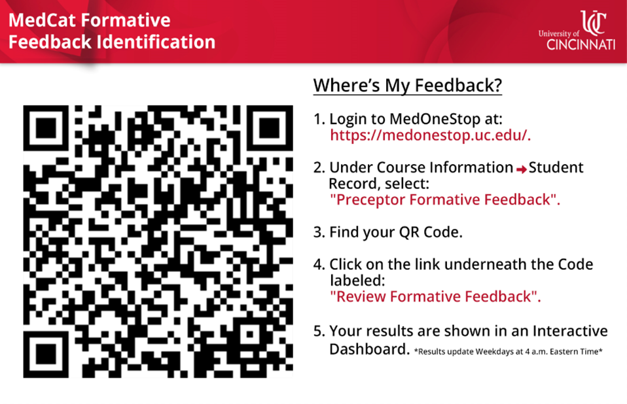
Providing Formative Feedback
Give it a try: Scan the QR code to view the form.
Note: Android users will need to download barcode scanner.

Slide 37
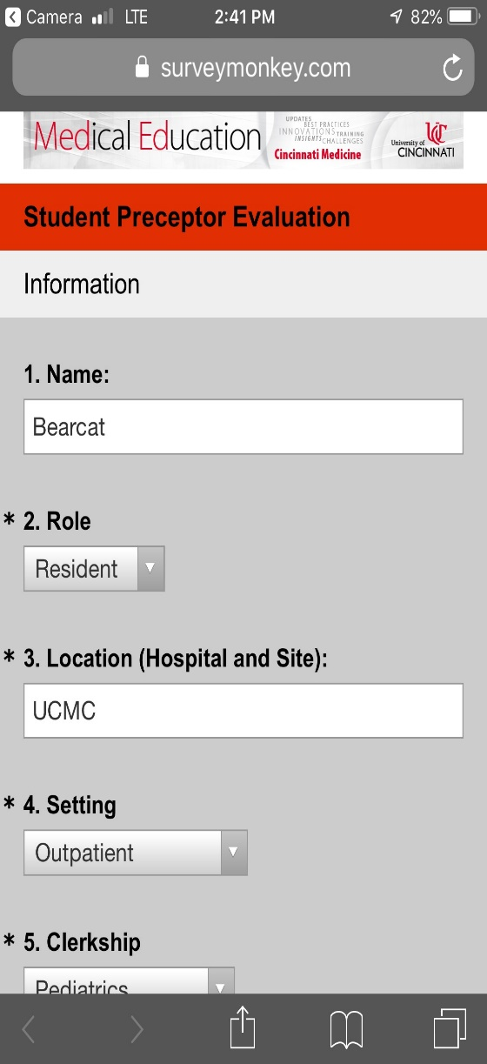
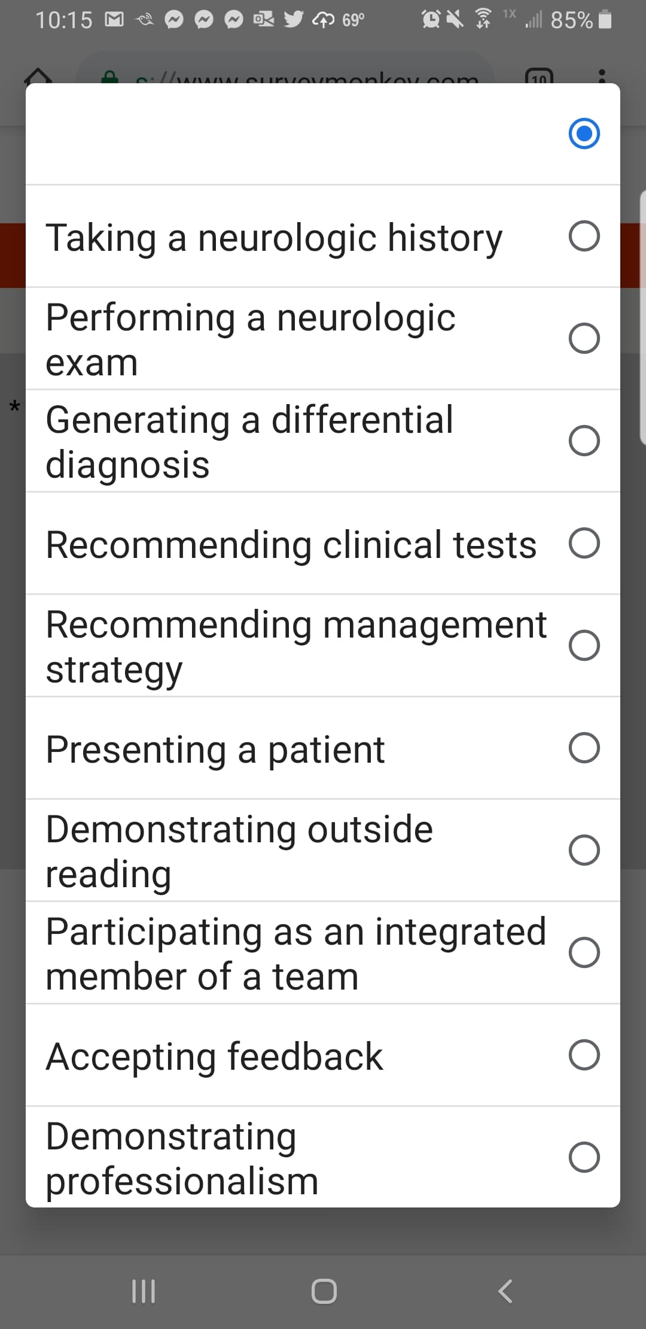
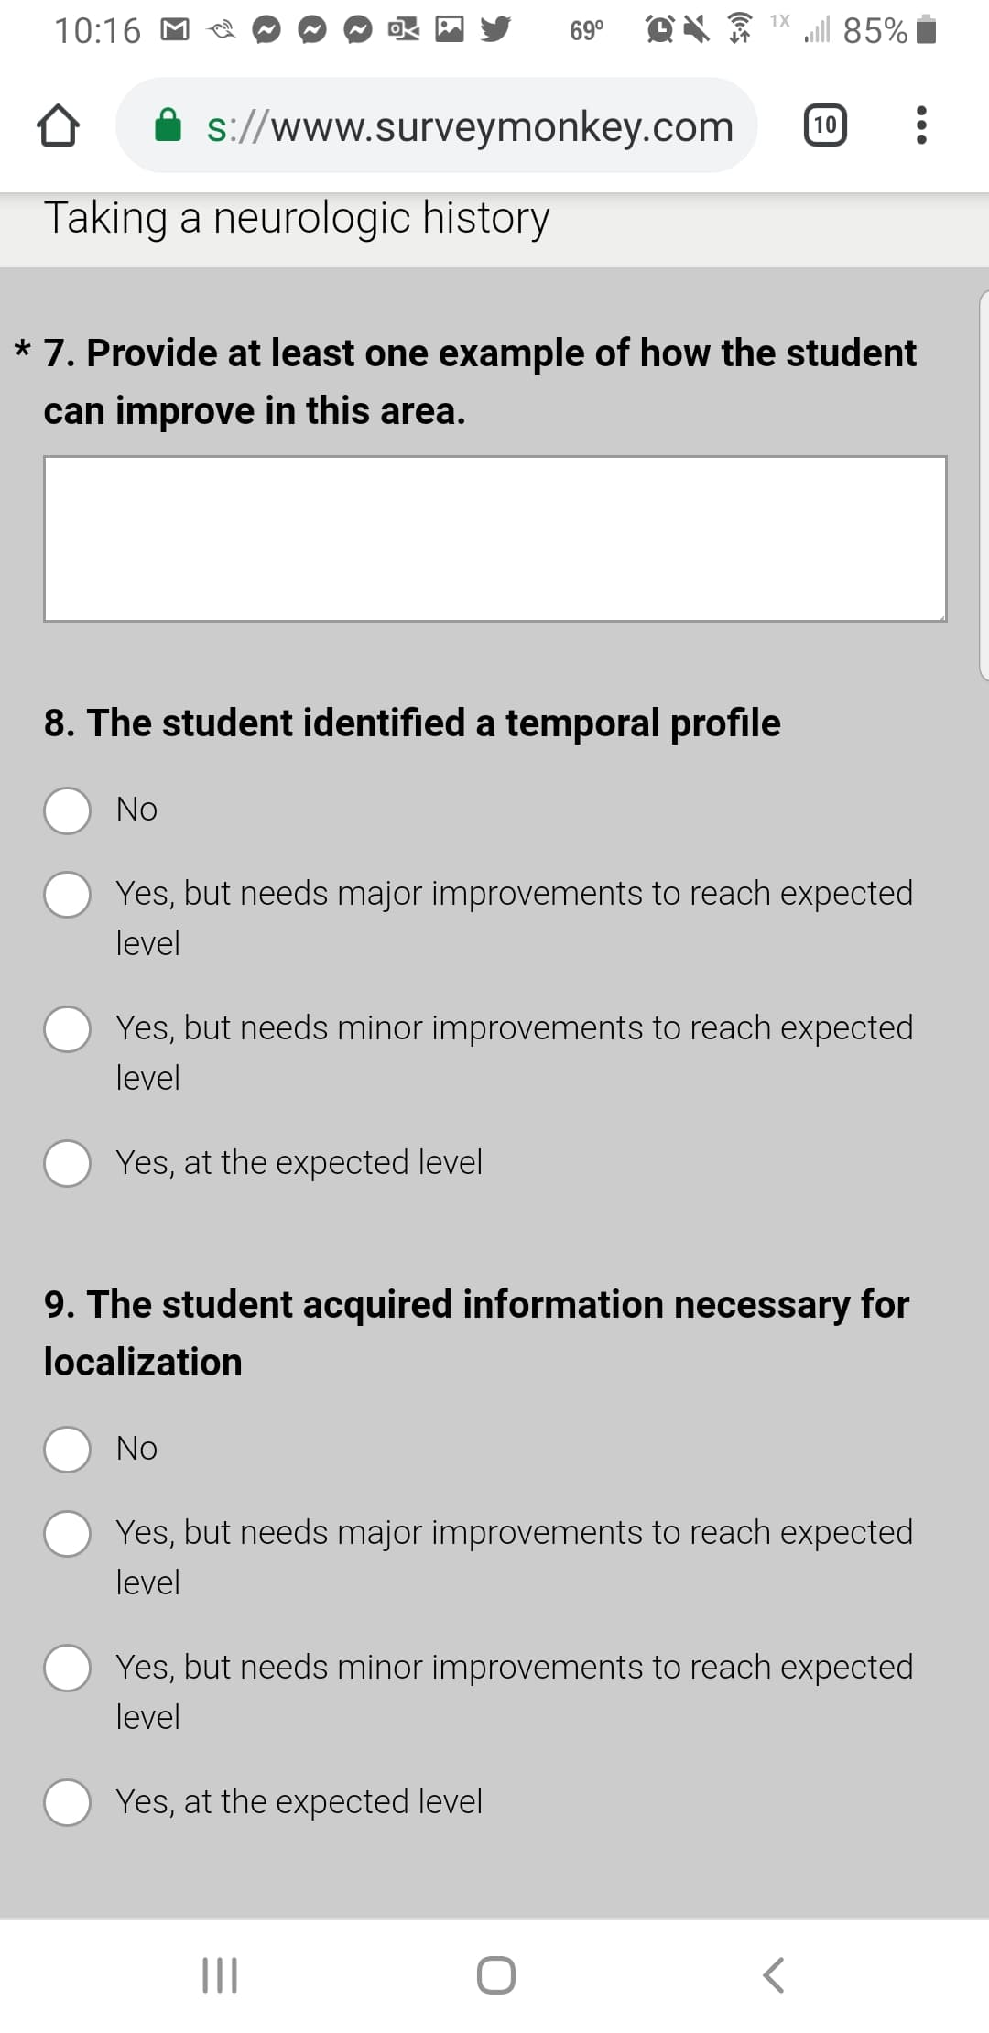
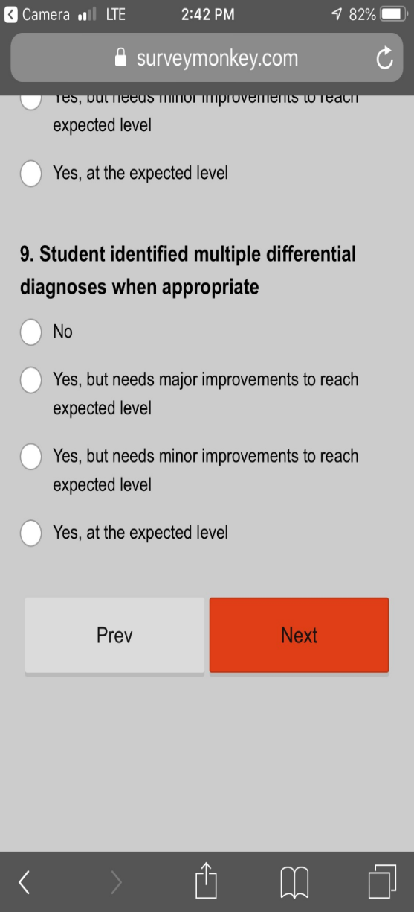
When you scan the QR code, you will see short assessments that include Likert items and a comment box for narrative feedback for that clerkship (see sample screenshots below)
These items and narrative feedback are mapped back to the UCCOM program objectives

Slide 38
Preceptor Summative Evaluation for Students
The preceptor evaluation is a summative evaluation worth 50%* of the student’s grade on a clerkship.
  *55% in internal medicine
There are two broad categories on the Preceptor Evaluation to assess student performance:
  Clinical Performance
  Teamwork and Self-Improvement Skills
Weighting of Preceptor Summative Evaluation Scoring
  90% for items falling under “Clinical Performance”
  10% for items falling under “Teamwork and Self-Improvement Skills”
Click here to view or download a sample evaluation form. Note that evaluations will vary by clerkship.
  M3 Form
  M4 Form

Slide 39
Preceptor Summative Evaluation for Students
Please keep these primary goals in mind in the assessment you provide:
Assess the students’ performance based upon the task rating scale
The task rating scale is based on what you would expect of a student at that level (i.e. an M3 student or an M4 student)
Most students should not receive the same rating for every item. Most students should not receive the highest rating.
Mark “did not observe” if you are unable to adequately assess an item
Write narrative feedback that is specific and based on description of behaviors
Click here to view a short video explaining how to think about the evaluation:
https://uc.mediaspace.kaltura.com/media/New+Preceptor+Evaluation-+Information+for+preceptors/1_rvkiabqk

Slide 40
Preceptor Summative Evaluation for Students
Please provide thoughtful, specific narrative comments
  Avoid comments like “read more” or “will develop this with time”
Good narrative comments are important for:
  Students to reflect and guide continued growth
  Students to understand their evaluation
  Creating the MSPE (i.e. Dean’s letter)
Please write narrative comments that reflect how you assessed the student’s performance as this is helpful to students and the clerkship/course director
Note, there is an area to provide comments that do not go in the students MSPE (i.e. Dean’s letter)

Slide 41
Policy on the Assessment of Student Performance by Faculty Healthcare Providers
All faculty members must recuse themselves from any role in assessment, evaluation, or grading of any medical student for whom they have provided healthcare services. If assigned to assess/evaluate/ grade a student for whom a faculty has provided care, the faculty must notify the course or clerkship director as soon as is possible, of the need for reassignment and must indicate on any related evaluation forms that he/she must recuse themselves from evaluating that student.
For full policy, click here.

Slide 42
Professional Development Opportunities in Teaching and Assessment
There are a variety of offerings each month through the College of Medicine Office of Faculty Affairs and Development.
  To view upcoming workshops, go to: https://med.uc.edu/about/admin-offices/faculty/development

Slide 43
Cincinnati Medicine Policies

Slide 44
KEY Cincinnati Medicine Policies and Procedures
Click on the policy names below to view the entire policy.
Principles Guiding Interactions Between Teachers and Learners in Medicine
Duty Hours
Student Attendance
  Note, absences related to student access to health services are considered excused.
  All absences must be approved by the appropriate coordinator or course director. Students must inform their clinical teams of any absences, but teams should not be determining if an absence is allowed.
Clinical supervision of students
Required Patient Encounters and Procedures
Discrimination, Harassment, or Retaliation Reporting Policy
All of these policies can be referenced in the Medical Student Handbook: https://med.uc.edu/education/medical-student-education/office-of-medical-education/student-handbook-policy-portal

Slide 45
Student Mistreatment - Discrimination, Harassment, or Retaliation
Allegations not involving sex, sexual orientation, gender, and/or gender identity or expression should be reported to any of the following offices:
Associate Dean for Student Affairs, Dawn Bragg, PhD
  Medical Sciences Building, Room E-450J
  (513) 558-0737
  braggds@ucmail.uc.edu
Assistant Dean for Diversity, Equity & Inclusion, Bi Awosika, MD
  Medical Sciences Building, Room E-251
  (513) 558-4898
  uccomdiversity@uc.edu
Associate Deans for Medical Education
Senior Associate Dean for Educational Affairs
Course/Clerkship/Elective Evaluations
Co-chairs of the Honor Council
Allegations involving sex, gender, and/or gender identity may have occurred should be reported directly to the Office of Gender, Equity, & Inclusion (“OGEI”)
USquare 308, 225 Calhoun St.
  (513) 556-3349 M-F 8a-5p
  ogei@uc.edu
Anonymous Reporting
ALERT – For College of Medicine Issues
Online Reporting:
https://comdo-wcnlb.uc.edu/emos/resources/reportmistreatment.aspx
EthicsPoint – General University Issues
Hotline: (800) 889-1547
Online Reporting: https://www.uc.edu/about/hotline.html

Slide 46
Anti-Racism
We at the College of Medicine abhor all racism against any individual or group and continue to pledge every effort to support people of all backgrounds.
Please refer to the Discrimination, Harassment, or Retaliation Reporting Policy.
  Discrimination, Harassment, or Retaliation Reporting Policy

Slide 47
Microaggressions
Microaggressions are defined as subtle forms of discrimination, often unconscious or unintentional, that communicate hostile or derogatory messages, particularly to and about members of historically marginalized social groups.
Microaggressions are well documented in the medical education literature.
YOU can be a role model and an advocate for our students.
Here are some resources on identifying and responding to microaggressions:
  Microaggressions in Clinical Training and Practice
  Responding to Microaggressions in the Classroom: Taking ACTION

Slide 48
Final Thoughts
Be the educator you wanted as a medical student.
We are all responsible for the future of medicine.
Thank you for your commitment to that future by working with the University of Cincinnati College of Medicine.

Slide 49
Thank you!

